Slide 1
Reflection of Light from a Concave Mirror Forming Real Images

Slide 2
When you have completed this lesson you should be able to:
Understand the behaviour of three principal rays drawn on ray diagrams to form a real image.
Draw ray diagrams showing the formation of a real image from a concave mirror.
Describe the nature of the real image produced by a concave mirror given the location of the object.

Slide 3

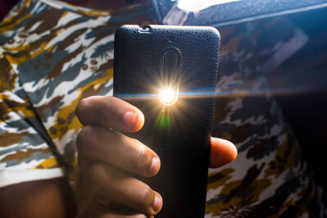
There are many uses of concave mirrors in everyday life.
When visiting the dentist, a small concave mirror is placed in our mouths to allow dentists to see larger images of our teeth.
Taking photos on your phone using the flash also utilizes concave mirrors. The mirror is able to focus beams of light and light up the desired area for a photo.
In this lesson, we will learn how concave mirrors are able to focus light and produce magnified images.

Slide 4
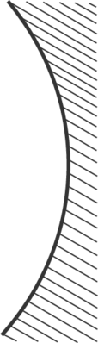
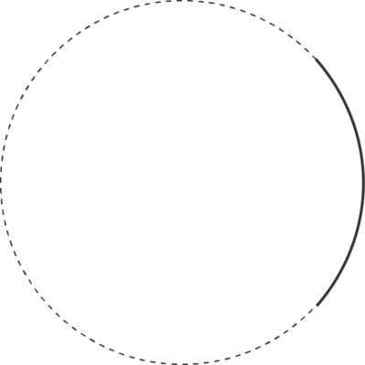
A concave mirror can be identified by the inward curve of the mirror.
An easy way to remember this is by using the end of the word concave; a cave always curves inward.
When drawing concave mirrors it can be useful to think of the mirror as part of a large circle. This will make sure that the drawn mirror has the correct degree of curvature. It is also standard to shade the non-reflecting side of the mirror, as shown in the diagram below.

Slide 5
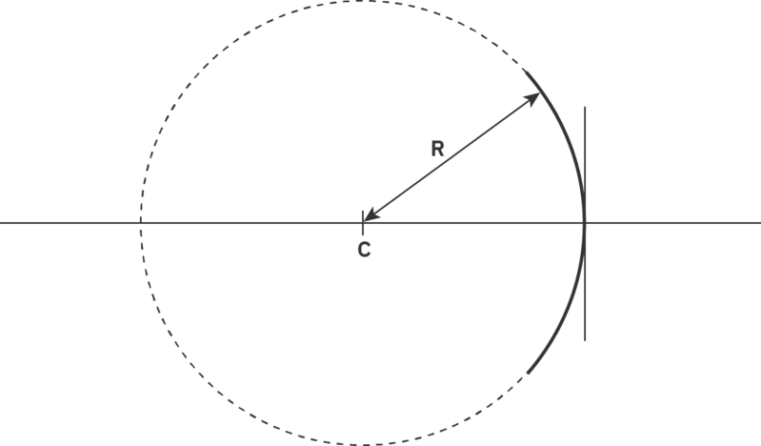
The larger circle that concave mirrors are part of can help identify properties of the mirror.
We define the centre of this large circle as the centre of curvature of the mirror, denoted by the letter C. The distance between the centre of curvature and the edge of the mirror is defined as the radius of curvature of the mirror and is represented by R (this can be written in upper or lower case).
The importance of this point will become clear when drawing ray diagrams, but for now you should know that the location of the object with respect to the centre of curvature of the mirror will affect the type of image produced.

Slide 6

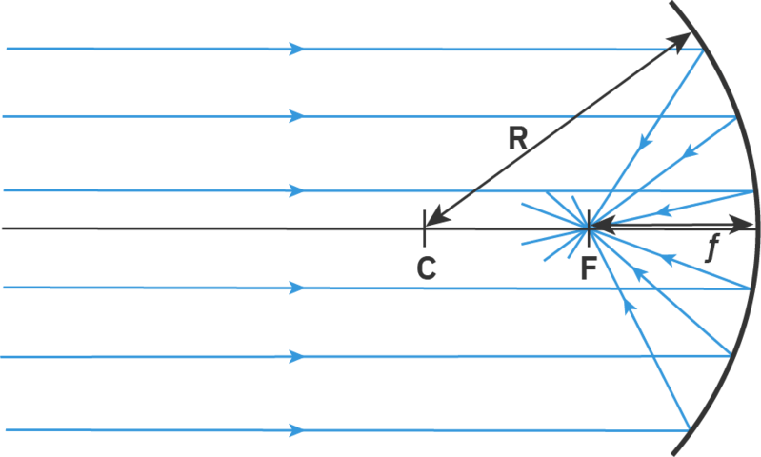
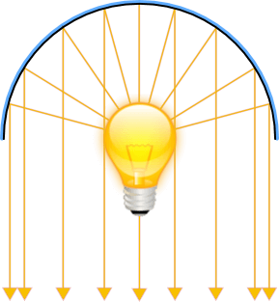
A concave mirror is a type of converging mirror.
This means light rays coming from a distant source (which are considered to be parallel to each other) hit the mirror, get reflected inward and all pass through the same spot (converge) in front of the mirror.

Slide 7
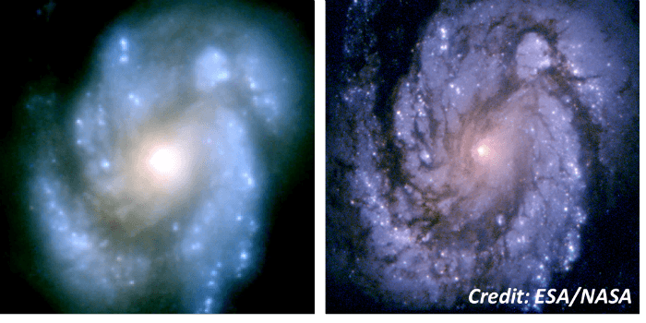
When all of the light rays converge at exactly the same point, it forms a sharp image.
In reality, it is extremely difficult to design a mirror where every light ray converges on the exact same point. There is usually a small region within which all of the light rays converge and this causes a slightly blurry image to form there.
This blurring of the image is usually shown when using spherical mirrors and hence is referred to as spherical aberration. If the size of the mirror is large compared to the radius of curvature of the mirror, then the image produced will be more affected by spherical aberration and will be blurrier.

Slide 8
A ray diagram is a drawing which can be used to describe the image formed by a concave mirror.
To draw a ray diagram we first need to draw some axes. The first of these is called the principal axis and consists of a horizontal line. The second axis is called the optical axis and it approximates the concave mirror as a vertical straight line. The optical axis is often placed near the right-hand end of the principal axis.
The intersection between the principal and optical axes is referred to as the pole (or centre) of the mirror and it is denoted by a P. Other properties of the mirror can also be included along the principal axis (e.g. the centre of curvature and the focus). The horizontal and vertical scales of ray diagrams do not have to be the same. In fact, the vertical scale is often much more magnified than the horizontal scale, so that the diagram is easier to draw.

Slide 9
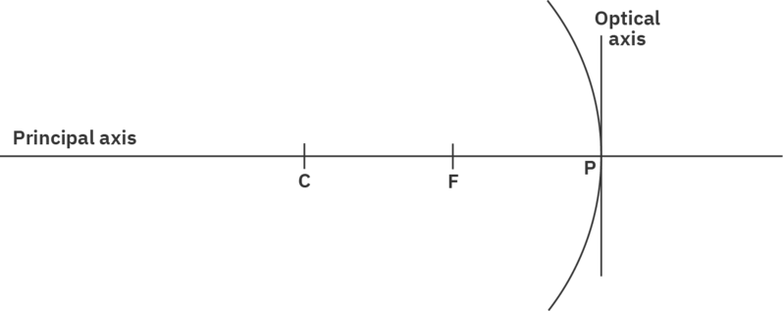

Slide 10
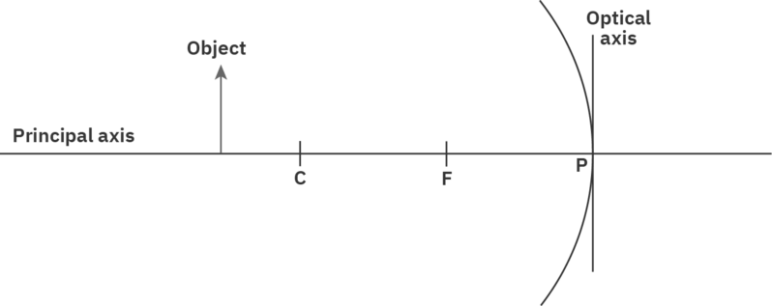
Once we have the axis of a ray diagram set up we can add the object and start to determine its reflected image.
The object is generally placed to the left of the optical axis and is represented by a vertical arrow, pointing upwards. This will make it much easier to determine the nature of the image.
The object is usually placed in relation to the properties of the mirror. For our first example, we will place the object outside (to the left of) the centre of curvature of the concave mirror.

Slide 11
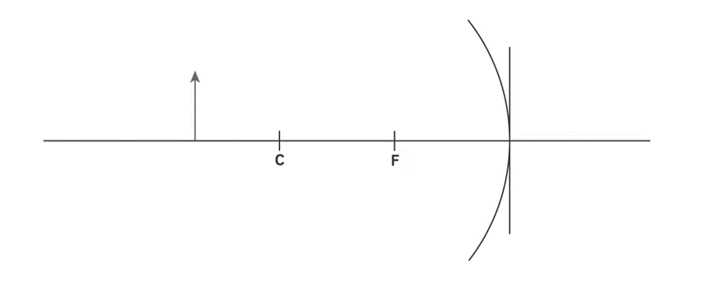
Now that we have set up our ray diagram, we can use three principal rays to determine the position of the image produced by a concave mirror.
The first principal ray we consider will start at the top of the object. It will then travel parallel to the principal axis until it reaches the optical axis (the mirror). As it reflects from the mirror it will travel through the focus of the mirror (where all the reflected rays of incident parallel rays will converge) and continue on beyond the ray diagram.
This is often shortened to: "an incident ray travelling parallel to the principal axis will be reflected through the focus of the mirror."

Slide 12

The second principal ray we will consider is the reverse process of the first principal ray.
The second principal ray will also start at the top of the object. It will then travel to the optical axis by passing through the focus of the concave mirror. Once it reaches the optical axis it will be reflected and travel away from the mirror parallel to the principal axis.
This rule is often shortened to: "an incident ray travelling through the focus will be reflected parallel to the principal axis."

Slide 13

The third principal ray we will consider uses the law of reflection.
The third principal ray starts at the top of the object (the same as the two previous rays). It then travels from the top of the object to the pole (centre) of the mirror. The centre of a concave mirror can be approximated as a plane mirror, thus we can use the law of reflection to understand what will happen to this ray.
The law of reflection states that the angle of incidence equals the angle of reflection. Thus, the angle between the incident ray and the principal axis will be the same as the angle between the reflected ray and the principal axis.
Shortening this rule: "A ray coming into the pole of the mirror will be reflected from the pole of the mirror with the same angle."

Slide 14
To determine the location of the image we need to combine three principal rays onto one diagram.
As we draw on three principal rays (always starting from the top of the object) we notice that the three reflected rays all converge at a point below the principal axis. This point of intersection between the three reflected rays identifies the top of the image.
We can trace this location vertically back to the principal axis to show the formation of the image. Although two of the principal rays would be sufficient to determine the location of the image, we include a third principal ray just to make sure we have the correct spot.
The image in the ray diagram below is formed between the centre of curvature and focus of the concave mirror.

Slide 15


Slide 16
It is not enough just to show the location of the image on a ray diagram. Often we also need to describe the nature of the image, consisting of three different properties.
In the ray diagram below, we can see that the image is upside down (compared to the object). The arrow is now pointing downwards instead of upwards. We refer to this as an inverted image. If the arrow points upwards in the image it would be called an upright image.
If we placed a screen at the location of the image, we would be able to see the image on the screen. Thus, we have created a real image, formed from real light rays. If an image is not real, it is referred to as a virtual image.
It turns out that real images are always inverted and inverted images are always real. Thus, if we know one of these properties we will know the other also.

Slide 17
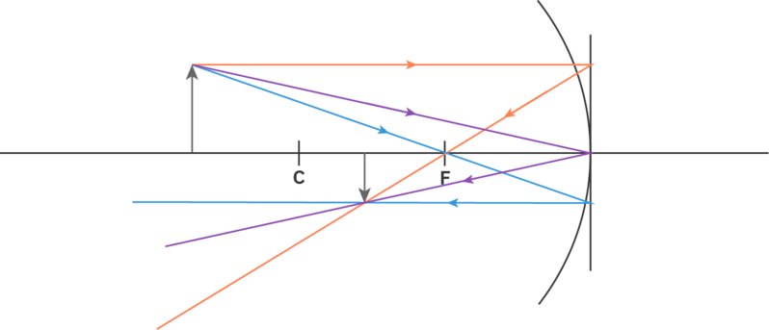
The last thing we need to consider to describe the nature of the image is its relative size.
The image in the ray diagram below is smaller than the object. We refer to this image as being diminished. If the image in the diagram had been larger than the object then we would refer to this as an enlarged image.
Thus to describe the nature of an image we must identify whether it is real or virtual, inverted or upright and enlarged or diminished. The nature of the image in the ray diagram below is real, inverted and diminished.

Slide 18
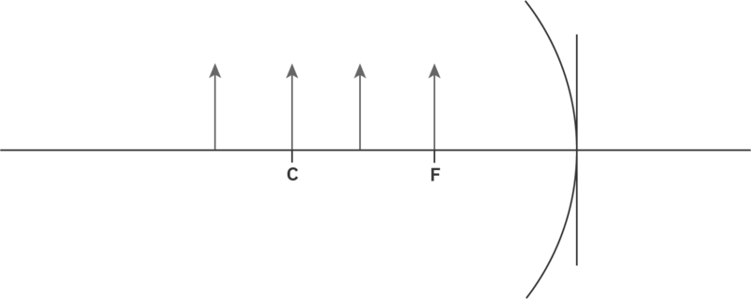
In the earlier ray diagrams, we always placed the object outside (to the left) of the centre of curvature of the mirror.
Now let's investigate what happens when the object is placed at different locations along the principal axis. In each of these situations we will describe the nature of the image, along with identifying its location.

Slide 19
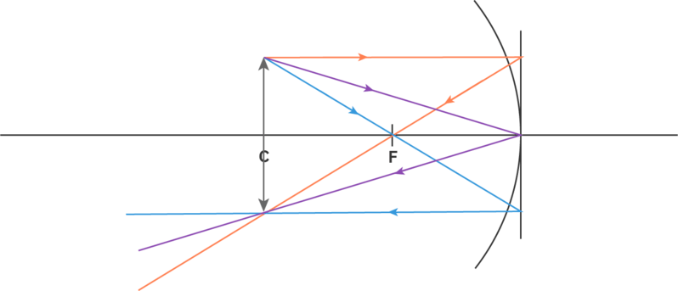
When we place the object at the centre of curvature we can use the same three principal rays to determine the location of the image.
The ray diagram for this situation is shown below and shows a real, inverted image. However, the image is the same size as the object (neither enlarged nor diminished) and the same distance from the mirror as the object.

Slide 20
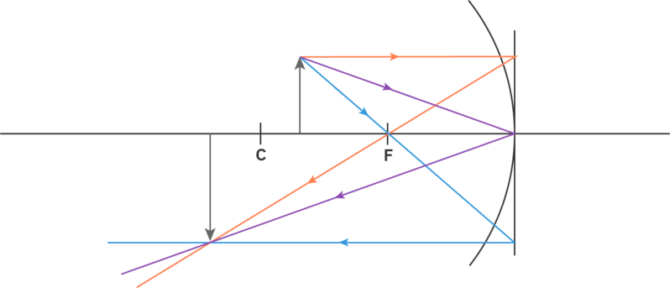
When the object is placed between the centre of curvature and the focus of a concave mirror, we can still use three principal rays to determine the position of the image.
The ray diagram is shown below, creating a real and inverted image that is larger than the object and is located beyond the centre of curvature of the mirror. Thus, this image is real, inverted and enlarged.

Slide 21
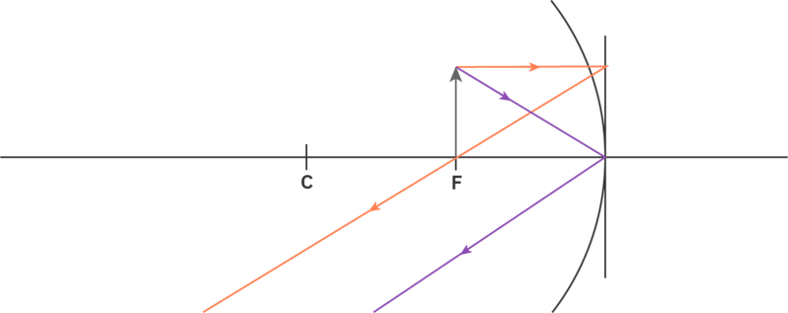
When the object is placed at the focus of the mirror, we can only use two of our three principal rays to determine the position of the image.
In this case, there is no light ray that can travel from the top of the object through the focus and to the mirror. Thus, we can only use the principal rays that are incident parallel to the principal axis and incident to the pole of the mirror.
These two principal rays are shown on the ray diagram below, and it is clear from the diagram that the two reflected rays do not intersect! As the reflected rays travel away from the mirror parallel to each other, we state that the image is formed at infinity and the nature of the image is unknown.

Slide 22
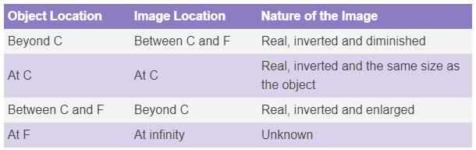
We have seen many different images formed up to this point so let's summarise all we have learned about the location of the object and the image formed.

